Slide 1
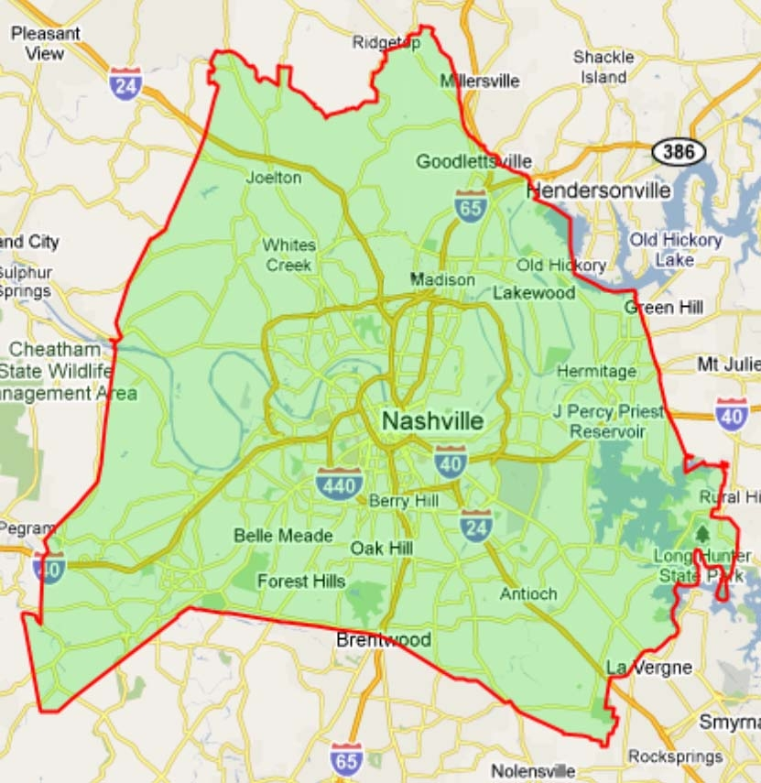
Davidson County Housing/Property Sale Analysis

Slide 2
Overview of Project :-
The purpose of this project is to analyze and visualize Davidson county housing / properties sales data with their nearby features. The features considered are schools, churches,bars,restaurants,liquor stores, convenience stores, drug stores,fire stations, hospitals, supermarkets etc.It helps in determining, which Davidson county’s nearby features put the most impact on property sales data and which features put the negative or positive impacts on the property sale. It can help analyse maximum and minimum property sales price, based on the property type and their nearby features. This project will provide analysis on following criteria :
Which nearby features put the most impact on property sale .
Which features put the negative or positive impact on property sale.
Max and Min properties sale price based on the property type and nearby features.
For analysing our data set, we have used the “Multivariate Linear Regression Model” .For visualization,we have used “Tableau”.We used SQLite database for this project. We used the SQLiteStudio tool to create tables and then imported csv files into tables. After that we used “Inner join” to join both tables. Since tableau itself has an embedded database,we are using that for our project.

Slide 3
Project Overview
Vandana - SQLite Database (What are the questions?) (Created worksheet to visualize data)1-2 minutes
Alecia - How we got the data (1-2 minutes) (How I got coordinates from address) (post a go-fund-me and warn about spending $ 200 doing api)
Chris - Machine Learning (2 slides) 3-5 minutes (Statistically Significant)
Tonja - Data Visualization (Demo) 3-5 minutes. Lead in with main map, focus on Liquor stores v. bars and vacant lots v. single family homes. Zone 2 (Brentwood)

Slide 4
Our Dataset
We obtained our data from the padctn.org website.
The data that we used contains all the sold properties in Davidson County in the month of September of 2021.
I used Jupyter Notebooks to clean up the data using Pandas.
I also used split str to get the latitude and longitude in separate columns instead of the two sharing a column as in the original dataset.
I also deleted duplicates and deleted datas that had na.
I also found deleted several unnecessary columns and created a new csv file.
We used the “Google Places” API in order to get the number of features nearby each address.
However, this cost us $200 due to pulling roughly 14,000 api calls in one day.
It would have saved us if we made one huge api call on a JSON file instead of doing all those api calls.
We decided to do it based on a 3.5 mile radius
Originally, it was going to be only one mile, but a lot of the data came up empty.
So I had to expand it based on a 3.5 mile radius just to get more tangible results.

Slide 5
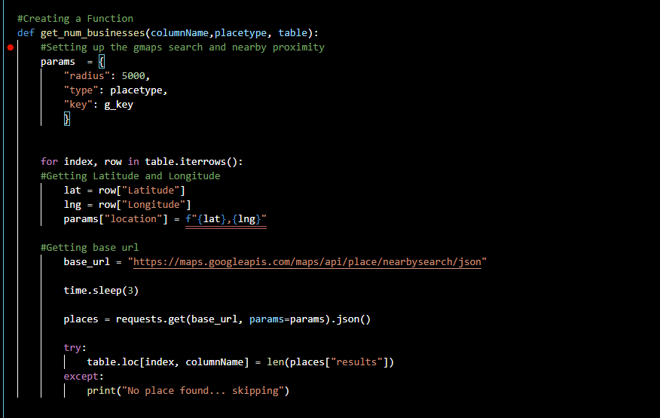
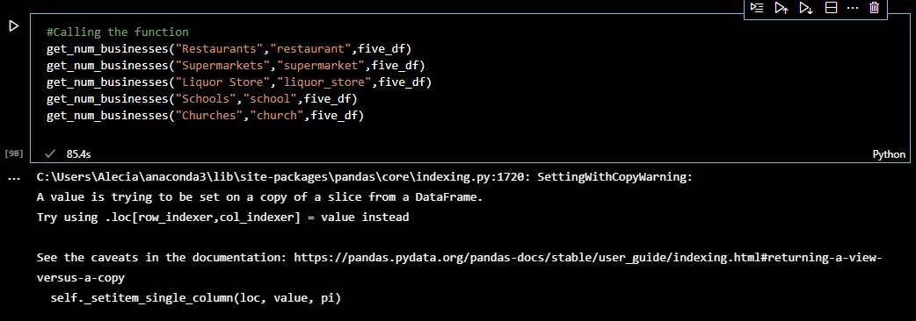
The API Call Function

Slide 6
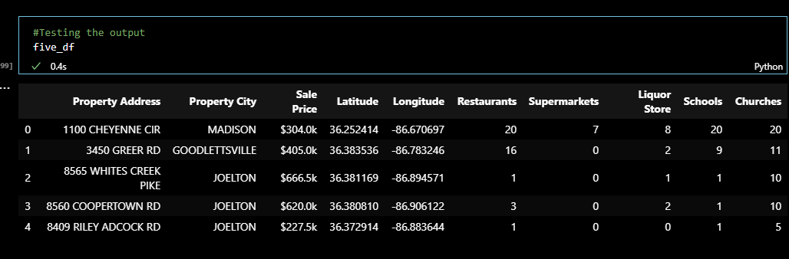
The Results

Slide 7
Machine Learning
We used a Multivariate Linear Regression Model using the statsmodels.api package for Python.
We used Sale Price as the dependent variable.
We used 10 Numeric Variables being the external features around the Properties(Bars, Convenience Stores,Churches,Drugstores,Fire Stations, Hospitals, Liquor Stores, Restaurants, Schools, and Supermarkets).
We had 4 Categorical Variables:
Address Ending(Ave, Cir, Rd,etc.)
House/Property Type(Single Family, Duplex, Condo, etc.)
Property City( Brentwood, Antioch, Whites Creek, etc.)
Zones(1-9).
The zones are in accordance to the data that was given by the Davidson County Property Assessor’s website.

Slide 8
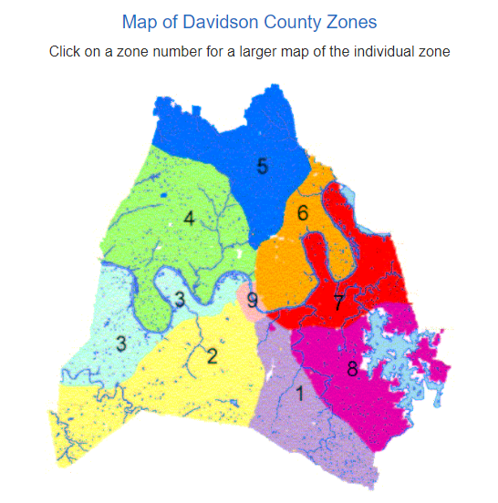
Davidson County Appraisal Zone Map
Notes:
This map is from the Davidson County Property Assessor’s office.

Slide 9
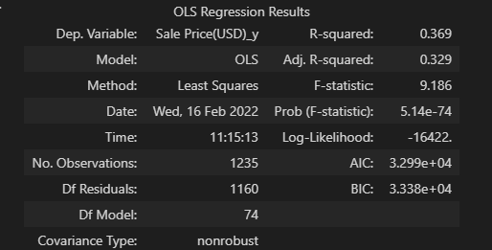
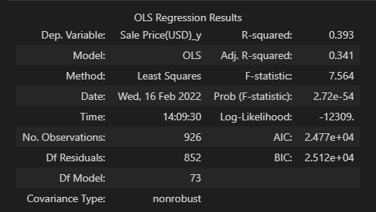
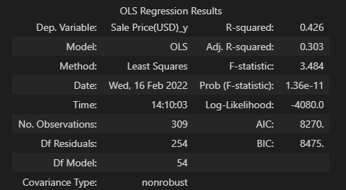
Full, Train, and Test Model Summary
Full Data Ordinary Least Squares Regression
Training Data Ordinary Least Squares Regression(Scaled Data)
Test Data Ordinary Least Squares Regression(Scaled Data)
Notes:
I decided to go off of the Full Data Regression when looking at the significant features.
The data performed well when going to the testing data in the normal R^2, however, performed worse in adjusted R^2 because of the number of variables in the model.
The model does not perform well with any of the data as it is staying around 0.36-0.42 for all models. I believe this is because of not having more pertinent house data like sq.ft, bedrooms, etc.

Slide 10
Info about Variables
Bars have a negative effect on the Property Price, while Liquor Stores have a positive effect on the Property Price. This could be because people are wanting to just drink at home instead of going out to drink, and this could be attributed to the pandemic.
Schools also have a negative effect on the Property Price.This could be because the measurement is all schools around the property not just good/bad schools.
Zone 2 and Zone 9 had the most positive effect on Property Price, and I believe that is because Zones 2 and 9 are the South Nashville/Brentwood area and Downtown Nashville respectively.

Slide 11

Data Visualization
Property Location Map and Features
Property Sales
Zones 2 and 9
Single Family Homes

Slide 12
LIVE DEMO
DATA VISUALIZATION STORY

Slide 13

QUESTIONS?

